Slide 1

HANDWRITTEN EQUATION SOLVER USING Neural Network
Presented By :
Parthibhan R(192124042),Kevin Allen TD(192224275)
Udhaya Kumar R(192221104)

Slide 2
2
OBJECTIVE
Extract handwritten equations from images
Utilize machine learning models to recognize characters and symbols within the equations.
Develop an algorithm to solve the recognized equations accurately.
Evaluate the performance of the system in terms of accuracy and efficiency

Slide 3
3
INTRODUCTION
To develop a system using a Neural Network that can recognize handwritten equations from images, interpret the characters and symbols, and solve the equations automatically.
It provides a convenient tool for users to solve math problems without the need for manual input or typing, streamlining the process of equation solving.

Slide 4
4
SUPPORT VECTOR MECHAIN
SVM machine learning algorithm used for classification and regression tasks. Its main objective is to find the optimal hyperplane that best separates data points into different classes or predicts continuous outcomes
Procedure for Naive Bayes:
Step 1: Initialize Input Variables
Step 2: Separate Data into Training and Testing Sets
Step 3: Train the Naive Bayes Model
Step 4: Predict Using the Trained Model
Step 5: Evaluate Performance
Step 6: Adjust Parameters (if necessary)
Step 7: Repeat if Necessary (adjusting parameters or features)

Slide 5
5
METHODOLOGY
Data Collection: Gather accurate and relevant employee data.
Data Preprocessing: Clean and enhance data quality for analysis.
EDA: Explore data relationships, patterns, and visualize insights.
Feature Engineering: Create or transform features for valuable information.
Model Development: Build predictive or statistical models.
Implementation: Apply analysis recommendations to HR practices.
Documentation: Document methodologies and findings, prepare concise reports.

Slide 6
EXISTING SYSTEM
Handwritten equation solving using Neural Network often involves users writing equations on a digital device and then processing them using Neural Network to extract relevant information.
HANDWRITTEN → DIGITAL NO
IDENTIFY INDIVIDUAL SYMBOL → PRAISING
SOLVING THE EQUATION
6

Slide 7
7
PROPOSED METHOD
To enhance the existing systems for handwritten equation solving using Neural Networks by developing advanced image processing techniques.
Focuses on optimizing the system performance in terms of accuracy, speed, and usability through the model.
To provide a reliable and efficient solution for solving handwritten equations with high accuracy.

Slide 8
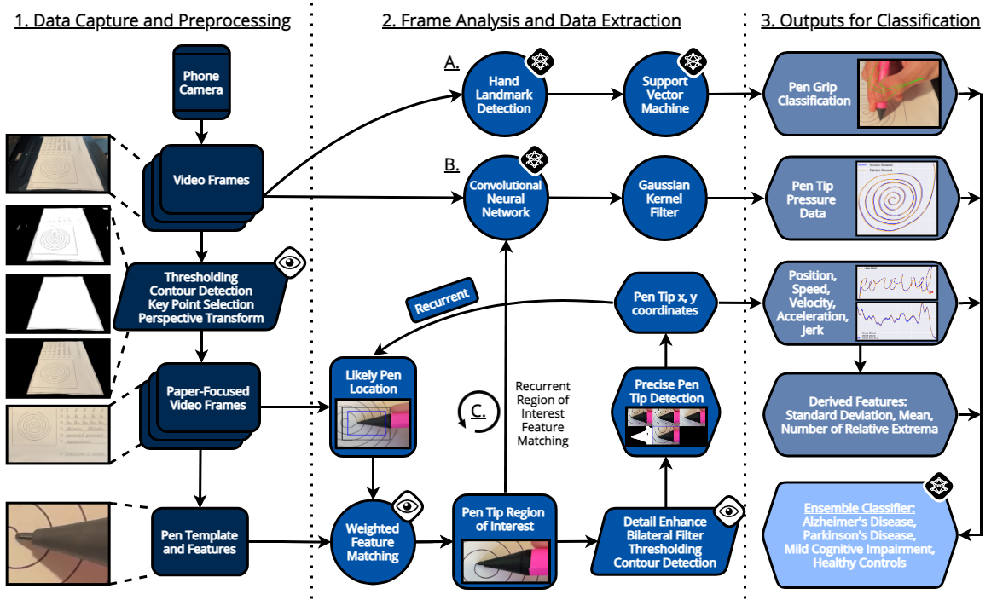
ANALYSIS
8

Slide 9
COMPARISION
Existing Method:
Relies on basic pre-processing techniques such as thresholding and simple noise reduction.
Uses standard contour detection algorithms with limited capability to handle complex handwritten symbols.
Proposed Method:
Implements robust contour detection and segmentation algorithms capable of accurately separating individual characters and symbols, even in cases of overlapping or touching elements.
Utilizes advanced pre-processing techniques like perspective correction, adaptive thresholding, and noise reduction algorithms to improve the quality of input images.
9

Slide 10
10
AREA FOR ENHANCING THE MODEL
Data Augmentation
Model Architecture
User Interface
Ensemble Methods
Error Analysis

Slide 11
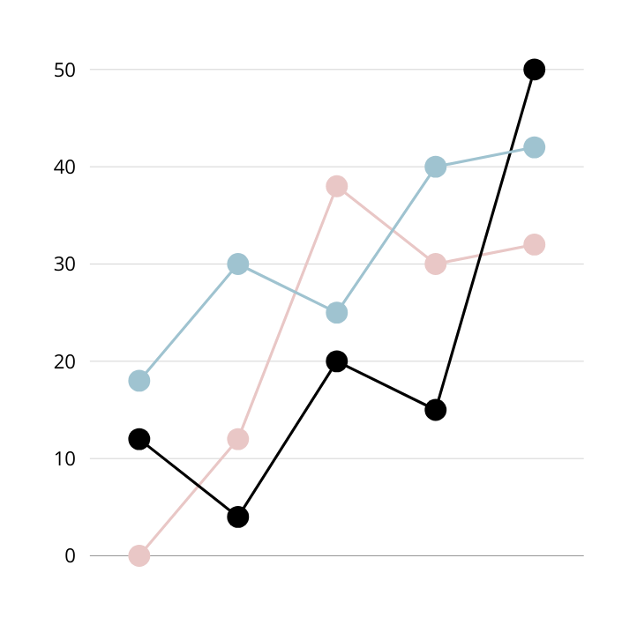
11
CONCLUSION
The Handwritten Equation Solver using Neural Network presents an effective method for interpreting and solving handwritten mathematical expressions, offering practical utility in streamlining mathematical tasks.

Slide 12
THANK YOU

